Slide 1
Assessment
On the VLE Module Assessment link
(ii) A report of the summer term Experimental Design Practical including an Appendix with R script.
logical folder structure
script, any accessory functions and the data itself.
script should be well-commented, well-organised and follow good practice in the use of spacing, indentation, and variable naming.
include all the code required to reproduce data import and formatting as well as the summary information, analyses, and figures in your report.
Examples of well-formatted scripts are given at the end of most workshops.

Slide 2

Laboratory & Professional skills for Bioscientists Term 2: Data Analysis in R
Two sample tests: two-sample t-test, two-sample Wilcoxon
Practical: one and two sample tests examples, different data formats ggplot.

Slide 3
Summary
Tests for one-, two-, and paired-samples (t-tests and non-parametric equivalents)
Today
two-sample t-test for independent samples
Wilcoxon for one- and two-samples when t-test assumptions are not met
Choosing appropriate tests: type of question, type of data
Second of two lectures; single workshop

Slide 4
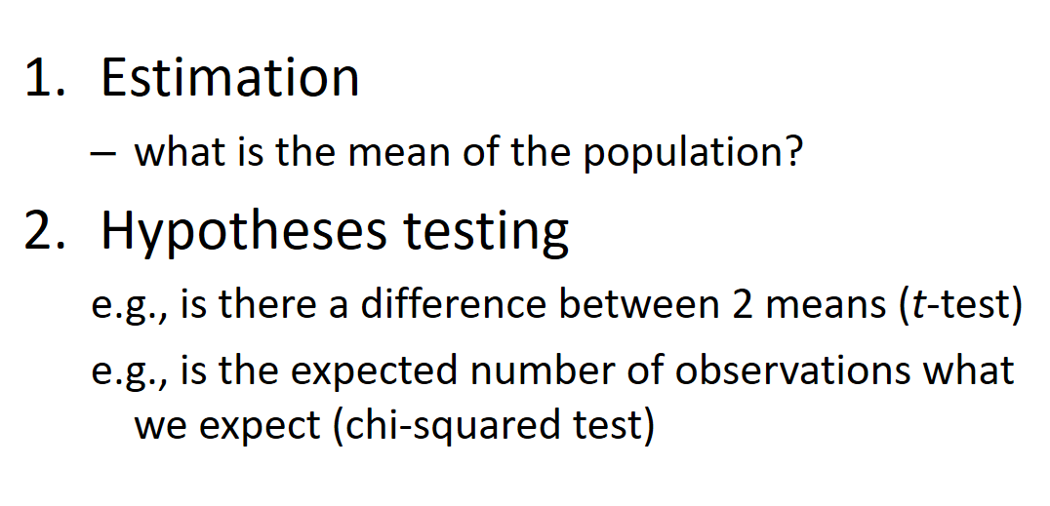
Overview of topics
Week | Topic
2 | Introduction. Logic of hypothesis testing
3 | Hypothesis testing, variable types
4 | Chi-squared tests
5 | The normal distribution, summary statistics and CI
6 and 7 | One- and two-sample tests (2 lectures)
8 | One-way ANOVA and Kruskal-Wallis
9 | Two-way ANOVA incl understanding the interaction
10 | Correlation and regression
Foundation
Hypothesis testing
Estimation
Hypothesis testing
Lecture 2

Slide 5
Learning objectives
Also in previous lecture
By actively following the lecture and practical and carrying out the independent study the successful student will be able to:
Explain dependent and independent samples (MLO 2)
Select, appropriately, t-tests and their non-parametric equivalents (MLO 2)
Apply, interpret and evaluate the legitimacy of the tests in R (MLO 3 and 4)
Summarise and illustrate with appropriate figures test results scientifically (MLO 3 and 4)

Slide 6
Types of t-test
Also in previous lecture
One-sample
Compares the mean of sample to a particular value (compares the response to a reference)
Includes paired-sample test for dependent samples (i.e., two linked measures)
Two-sample
Compares two (independent) means to each other

Slide 7
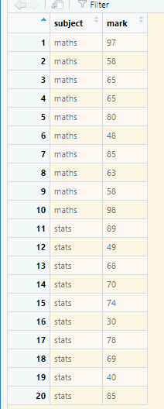
Is there a difference between the maths and stats marks of 10 students? The one sample is the difference between the pairs of values
t-tests Paired-sample t-tests example
Also in previous lecture
Same student

Slide 8
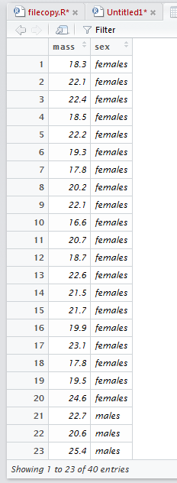

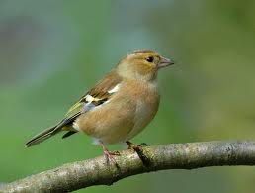
Two-sample t-tests
NEW!
Is there a difference between two independent means
Independent – values in one group not related to values in the other group
Example: is there a significant difference between the masses of male and female chaffinches?
NOT
LINKED
Fringilla coelebs

Slide 9
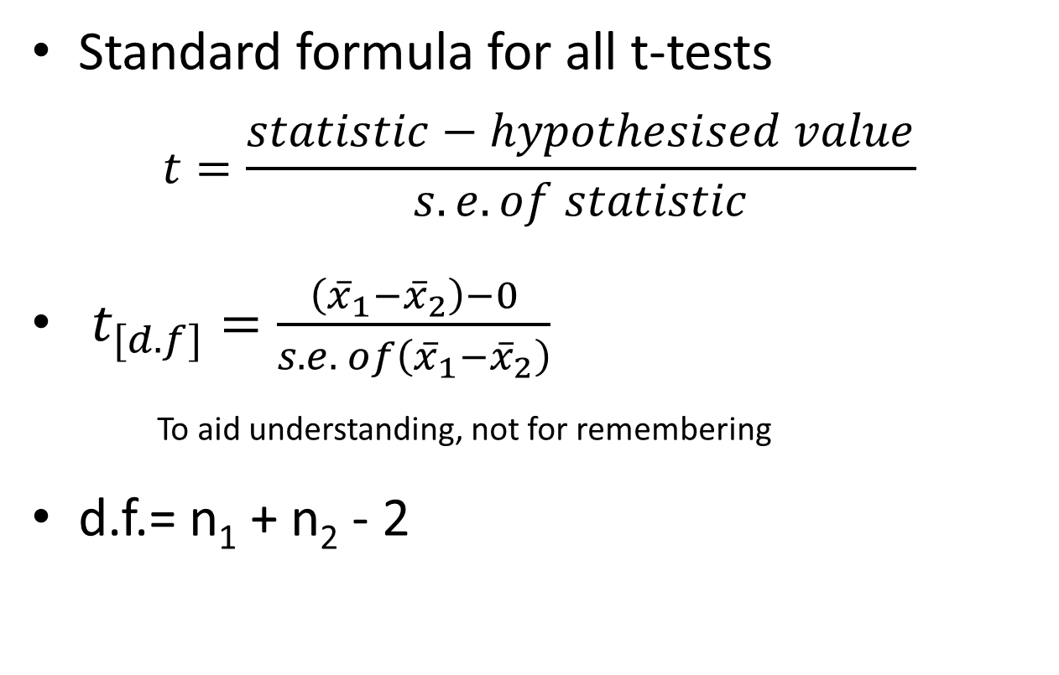
t-tests
Also in previous lecture
Standard formula for all t-tests
$$t=\frac{statistic−hypothesised value}{s.e. of statistic}$$
$t_{[d.f]}=\frac{\left({\overline{x}}_{1}−{\overline{x}}_{2}\right)−0}{s.e. of\left({\overline{x}}_{1}−{\overline{x}}_{2}\right)}$
To aid understanding, not for remembering
d.f.= n₁ + n₂ - 2
NEW!
Notes:
i.e., the number in the sample of differences

Slide 10
t-tests in general Assumptions
Also in previous lecture
All t-tests assume the “residuals” are normally distributed and have homogeneity of variance
A residual is the difference between the predicted and observed value
Predicted value is the mean / group mean

Slide 11
t-tests in general: assumptions Checking Assumptions
Also in previous lecture
- Common sense
response should be continuous
No/few repeats
- Plot the residuals
- Using a test in R

Slide 12
t-tests in general: assumptions When data are not normally distributed
Also in previous lecture
Transform (not really covered)
E.g. Log to remove skew, arcsin squareroot on proportions
Use a non-parametric test (covered)
Fewer assumptions
Generally less powerful

Slide 13
t-tests Two-sample t-test example
NEW!
Example: is there a significant difference between the masses of male and female chaffinches?
Fringilla coelebs

Slide 14
t-tests Two-sample t-test example
NEW!
chaff <- read.table("../data/chaff.txt", header = T)
Note: these data are ‘tidy’
All the responses in one column with other variables indicating the group
Organise your
data this way

Slide 15
Tidy data
Extension of previous lect
Each variable should be in one column.
Each different observation of that variable should be in a different row.
There should be one table for each "kind" of variable.
If you have multiple tables, they should include a column in the table that allows them to be linked.
Independent study: Wickham, H (2013). Tidy Data. Journal of Statistical Software.
https://www.jstatsoft.org/article/view/v059i10

Slide 16
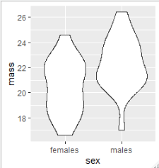
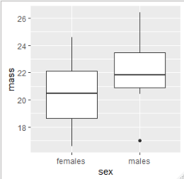
t-tests Two-sample t-test example
Plot your data: roughly – perhaps one of these…
ggplot(data = chaff,
aes(x = sex, y = mass)) +
geom_violin()
ggplot(data = chaff,
aes(x = sex, y = mass)) +
geom_boxplot()

Slide 17
t-tests Two-sample t-test example
Plot your data: don’t overthink. Just gives you idea of what to expect and helps identify issues (missing data, outliers etc)

Slide 18
t-tests Two-sample t-test example
Summarise the data:
chaffsum <- chaff %>%
group_by(sex) %>%
summarise(mean = mean(mass),
std = sd(mass),
n = length(mass),
se = std/sqrt(n))
chaffsum
# A tibble: 2 x 5
sex mean std n se
<fct> <dbl> <dbl> <int> <dbl>
1 females 20.5 2.14 20 0.478
2 males 22.3 2.15 20 0.481

Slide 19
t-tests Two-sample t-test example
Run the t-test
Name of the dataframe
t.test(data = chaff,
mass ~ sex,
paired = F,
var.equal = T)
The ‘model’ explain mass by sex
The data are not paired, they are independent
We are assuming homogeneity of variance

Slide 20
t-tests Two-sample t-test example
Run the t-test
t.test(data = chaff,
mass ~ sex,
paired = F,
var.equal = T)
data: mass by sex
t = -2.6471, df = 38, p-value = 0.01175
alternative hypothesis: true difference in means is not equal to 0
95 percent confidence interval:
-3.167734 -0.422266
sample estimates:
mean in group females mean in group males
20.480 22.275

Slide 21
t-tests Two-sample t-test example
Checking the assumptions: calculate the residuals – the difference between predicted and observed (i.e., group mean and value)
# add the group means to the data
chaff <- merge(chaff, chaffsum[,1:2], by = "sex")
# add the residuals
chaff <- chaff %>%
mutate(residual = mass - mean)

Slide 22
t-tests Two-sample t-test example
Checking the assumptions: normally and homogenously distributed residuals
shapiro.test(chaff$residual)
Shapiro-Wilk normality test
data: chaff$residual
W = 0.98046, p-value = 0.7067

Slide 23
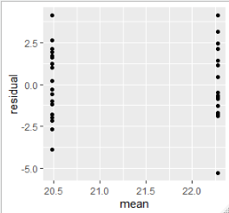
t-tests Two-sample t-test example
Checking the assumptions: normally and homogenously distributed residuals
Variance is about the same
for all values of x
ggplot(data = chaff,
aes(x = mean, y = residual)) +
geom_point()

Slide 24
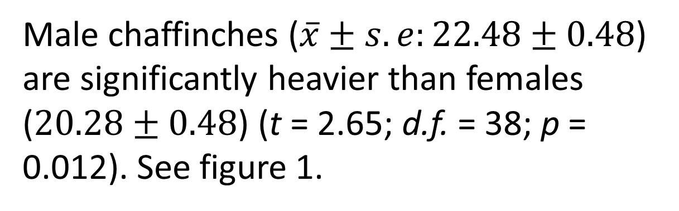
t-tests Two-sample t-test example
Extension of previous lect
Reporting the result: “significance of effect, direction of effect, magnitude of effect”
Male chaffinches ($\overline{x}±s.e:22.48±0.48$) are significantly heavier than females ($20.28±0.48$) (t = 2.65; d.f. = 38; p = 0.012). See figure 1.

Slide 25
t-tests Two-sample t-test: figures
NEW!
Supports your claim:
Show the data (all if possible)
Show the ‘model’ (the predicted values i.e., means and error bars)
Say what kind of error bars
Full but concise figure legends

Slide 26
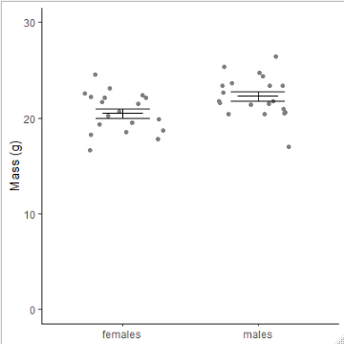
t-tests Two-sample t-test: figures
NEW!
Figure 1. Mean mass of male and female chaffinches. Error bars are means +/- one standard error.

Slide 27

NEW!
Figure 1. Graph to show mass of male and female chaffinches. Error bars are means +/- one standard error.

Slide 28
When the t-test assumptions are not met: non- parametric tests
Non-parametric tests make fewer assumptions
Based on the ranks rather than the actual data
Null hypotheses are about the mean rank (not the mean)

Slide 29
Non-parametric tests t-test equivalents
i,.e., the type of question is the same but the response variable is not normally distributed
one – sample t-test and paired-sample t-test: the one-sample Wilcoxon
Two-sample t-test: two-sample Wilcoxon aka Mann-Whitney

Slide 30
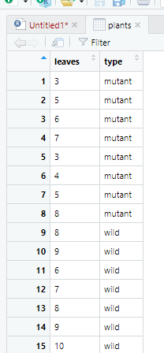

Non-parametric tests two-sample Wilcoxon (Mann-Whitney)
Example: comparing the number of leaves on 8 mutant and 7 wild type plants (small samples, counts)

Slide 31
Non-parametric tests two-sample Wilcoxon (M-W): example
Carrying out the test two-sample Wilcoxon
wilcox.test(data = plants, leaves ~ type, paired = FALSE)
Wilcoxon rank sum test with continuity correction
data: leaves by type
W = 5, p-value = 0.008664
alternative hypothesis: true location shift is not equal to 0
Warning message:
In wilcox.test.default(x = c(3, 5, 6, 7, 3, 4, 5, 8), y = c(8, 9, :
cannot compute exact p-value with ties
No need to worry!

Slide 32
Non-parametric tests two-sample Wilcoxon (M-W): example
Reporting the result: “significance of effect, direction of effect, magnitude of effect”
There are significantly more leaves on wild-type (median = 8) than mutant (median = 5) plants (Mann-Whitney: W=5, n₁=7, n₂=8, p = 0.009)
32

Slide 33
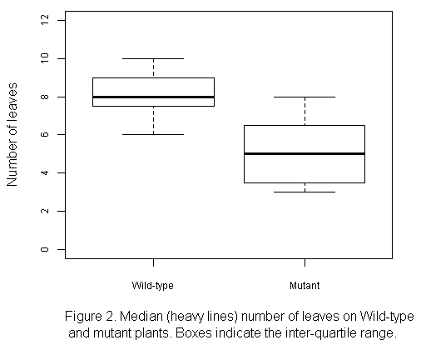
Non-parametric tests two-sample Wilcoxon (M-W): example
Label with units
Non-parametric tests: use median+IQR
Measure of dispersion - IQR
What is the figure?
Always refer to figure in the text

Slide 34
Learning objectives for the week
By attending the lectures and practical the successful student will be able to
Explain dependent and independent samples (MLO 2)
Select, appropriately, t-tests and their non-parametric equivalents (MLO 2)
Apply, interpret and evaluate the legitimacy of the tests in R (MLO 3 and 4)
Summarise and illustrate with appropriate R figures test results scientifically (MLO 3 and 4)

